Slide 1

COURSE WORK: PROGRAMMING FOR DATA SCIENCE 2025.1 BATCH
COMScDS251P-015

Slide 2
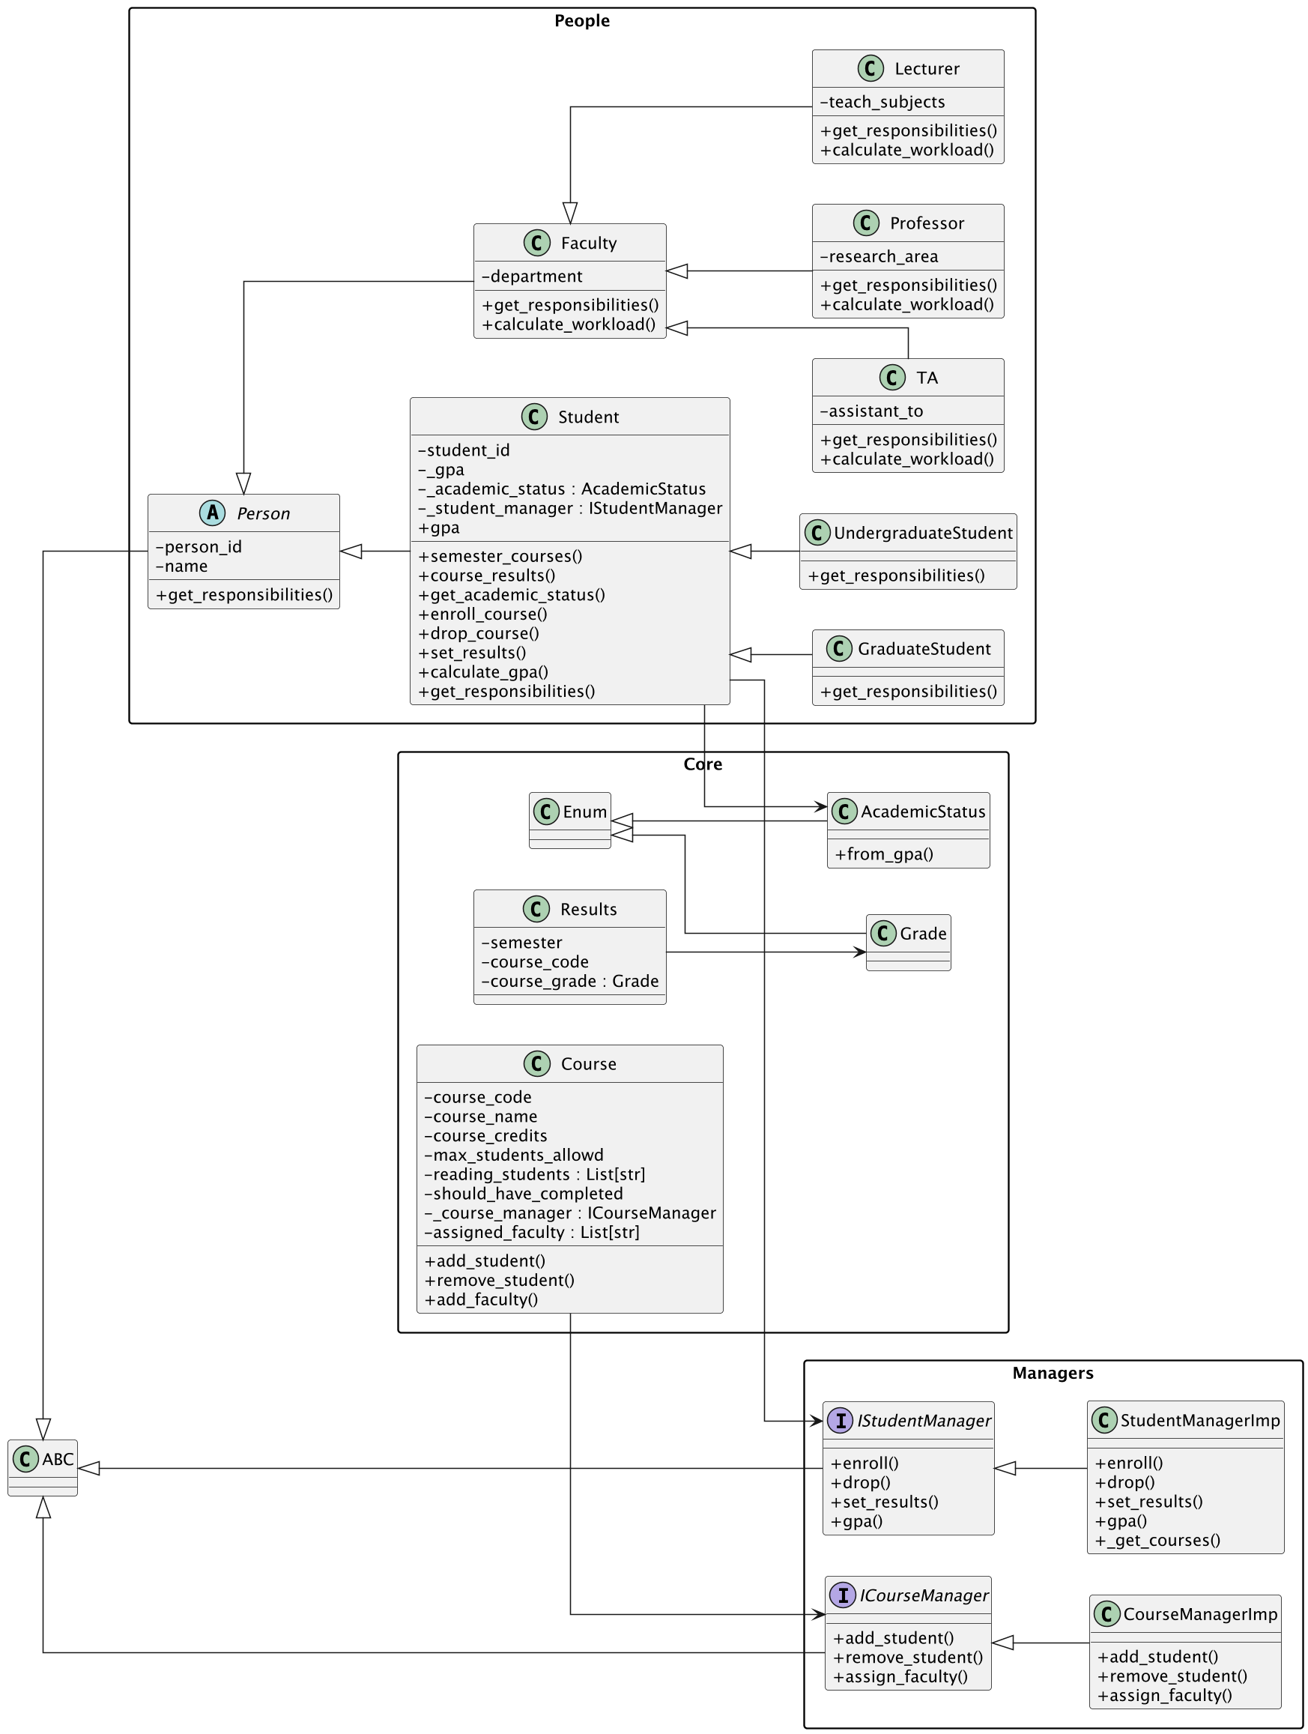
1. University SYSTEM

Slide 3
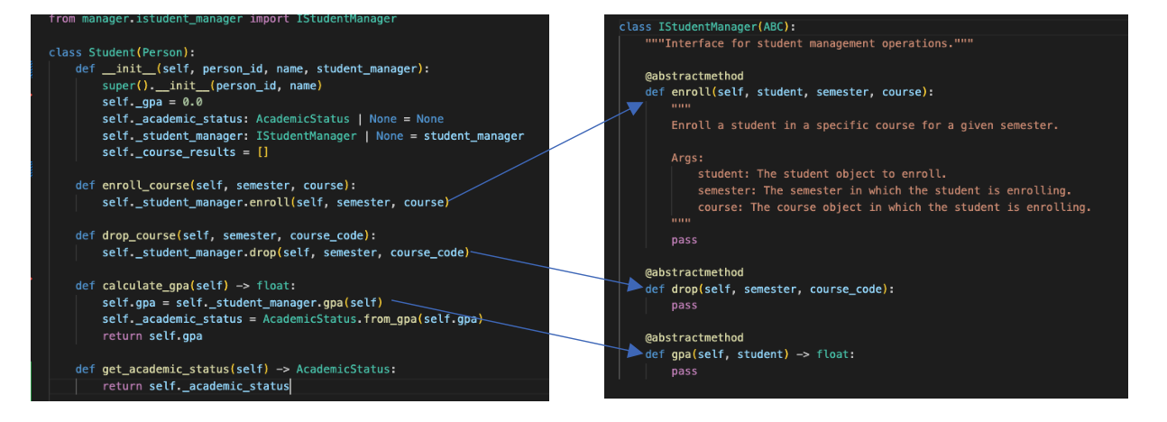
Course Enrollment
Cleaner Student class by focuss on data attributes
Implmentation with StudentManager class with Imp seperation

Slide 4
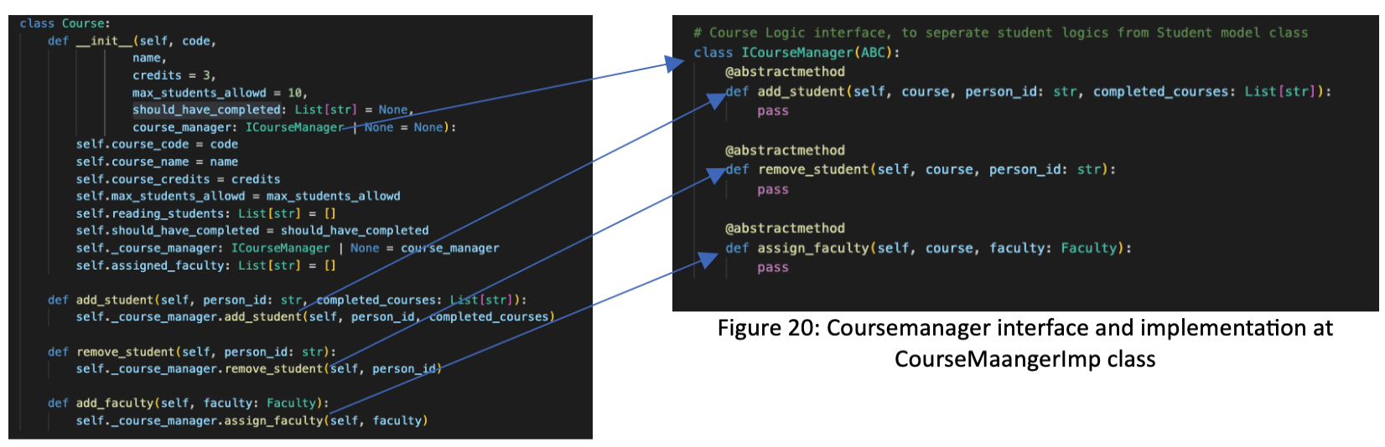
Courses Manager
Course Class - future proof
Course
Credits
Max student allowed
Prerequisites

Slide 5
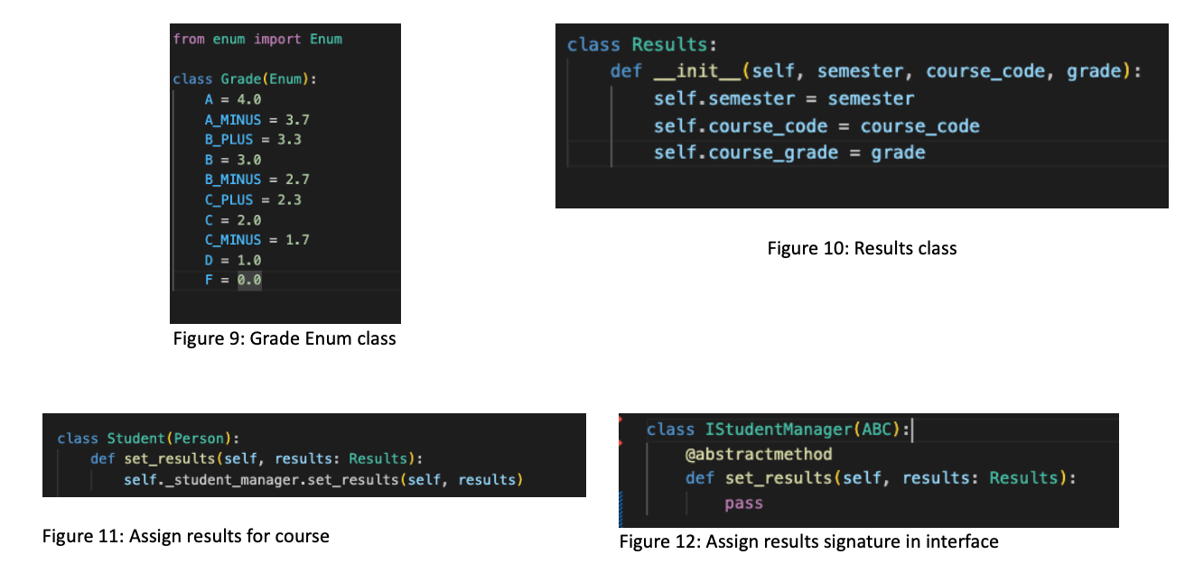
Course Enrollment and Results
Results and Grade
Validation with raise
Enroll - Already enrolled
Drop – Not Found
Set Results – Not Found
GPA – No Courses

Slide 6
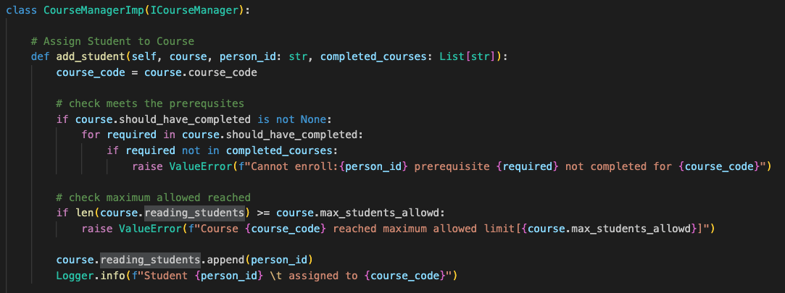
Course Manager Validation

Slide 7
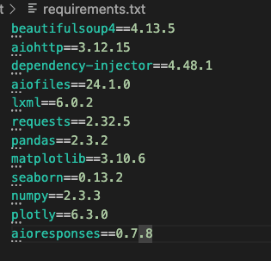
2. Data Analysis: E-commerce Data Analysis

Slide 8
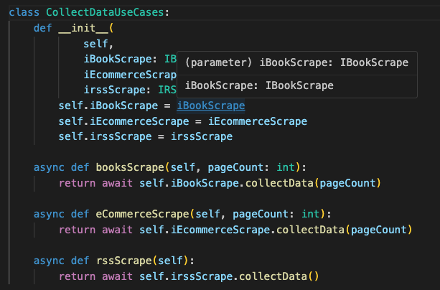
2.1 Multi Source Data Collection
Clean architecture (domain/data)
Domain/Usecases
CollectDataUseCases [BookScrape, EcommerceScrape, RSSScrape]
SaveDataUseCases [SaveJson]
Managers
IhttpClient, IsaveFile, IbookScrape, IECommerceScrape, IRSSXMLScrape

Slide 9
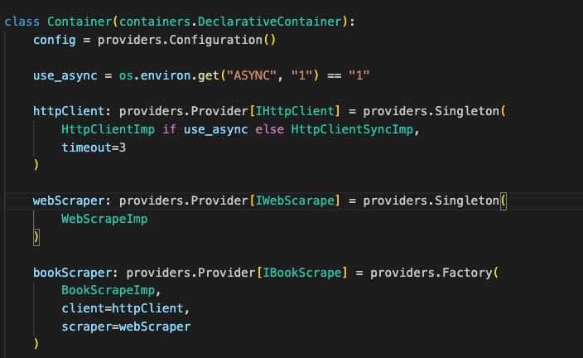
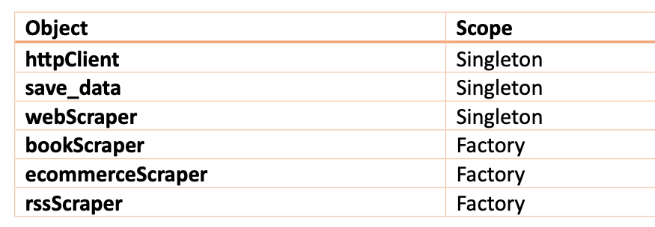
Multi Source Data Collection
DI

Slide 10
Multi Source Data Collection
Async Requests [coroutines/non thread blocking]
Blocking Request also added (enable with cmd env param)
Retrying failed requests
Exponential backoff
Random jitter
Utils
Logger interface with console log imp
Ececution time
Unit Tests and Mocks

Slide 11
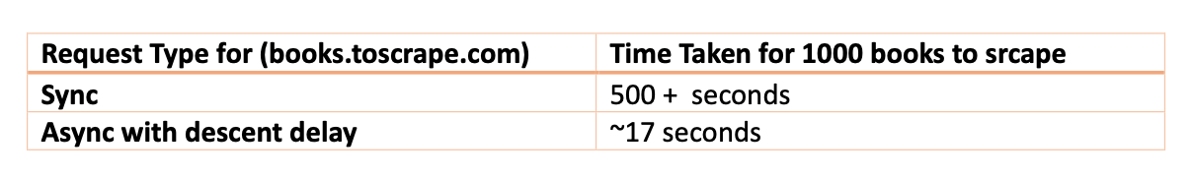
Book Scrape Improvements
Performance
Retry

Slide 12
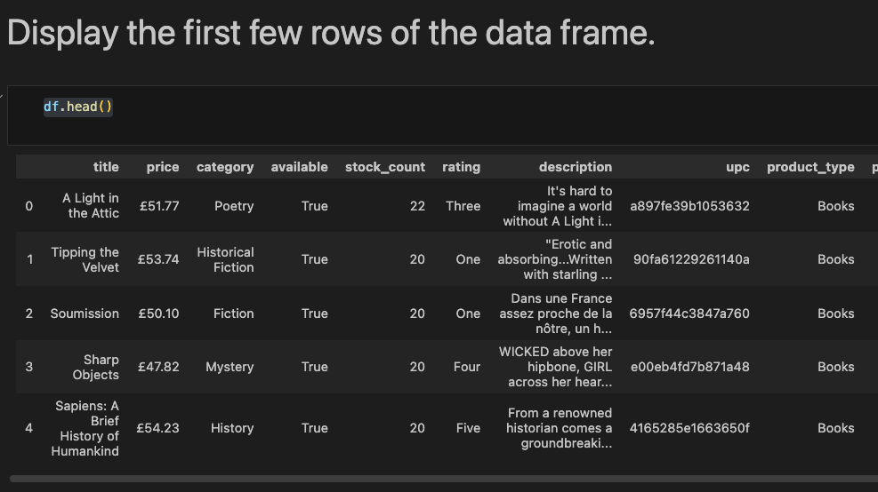
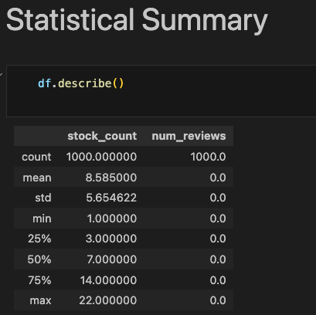
2.2 Data Cleaning and Preprocessing
£ need to remove ["price", "price_excl_tax", "price_incl_tax", "tax"]
No Use

Slide 13
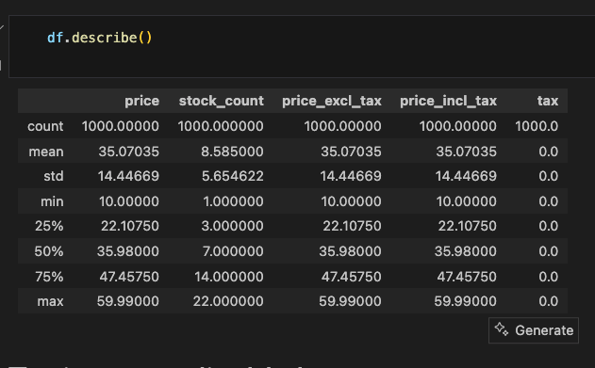
2.2 Data Cleaning and Preprocessing
Drop
price_excl_tax
price_incl_tax
tax

Slide 14
2.2 Data Cleaning and Preprocessing
Text Normalization
Remove ...more
Remove leading and trailing white spaces
Remove tabs, consecutive white spaces with single white space
Drop Further columns with analysis
product_type which are not books are 0 – we can drop product_type column
Not available also 0 – we can drop available column
Int values for Rating, Currently string which not optimal
Save as Jsonl

Slide 15
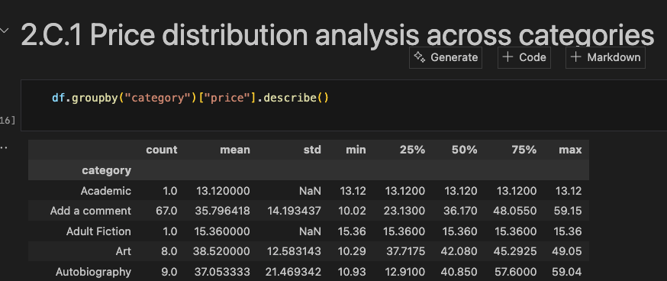
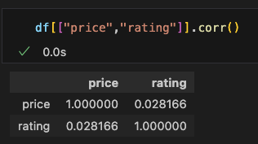
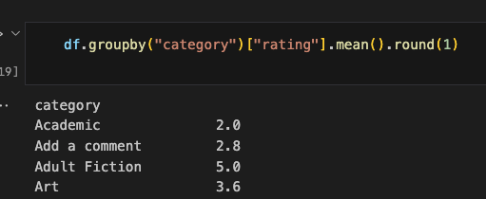
2.3 Advanced Statistical Analysis
Default has 152 books and some categories has only 1
Health are Expensive (Avg 51.45)
Crime are Cheaper (10.97)
Autobiography has large price variation (std:21.47)
Health has consistent price (2.45)
Adult Fiction has highest rating(5) and crime has lowest(1)
Book price gives no information about its rating, not coorelated.

Slide 16
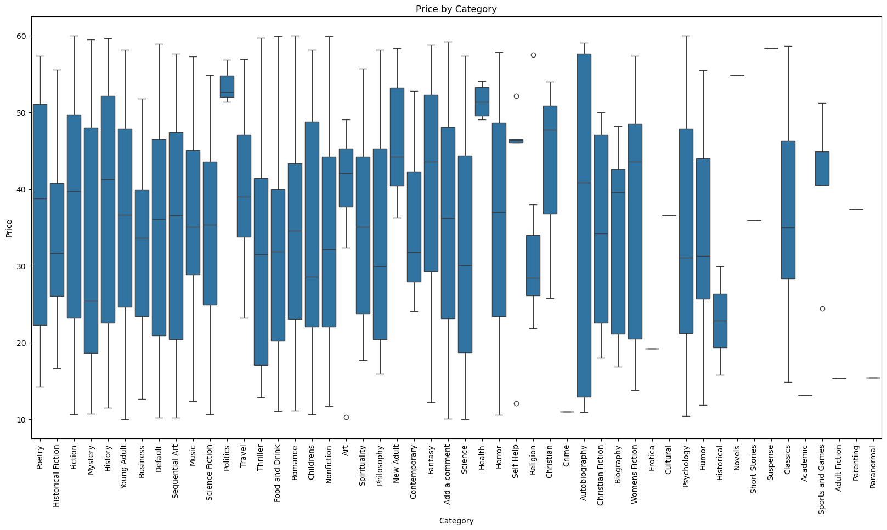
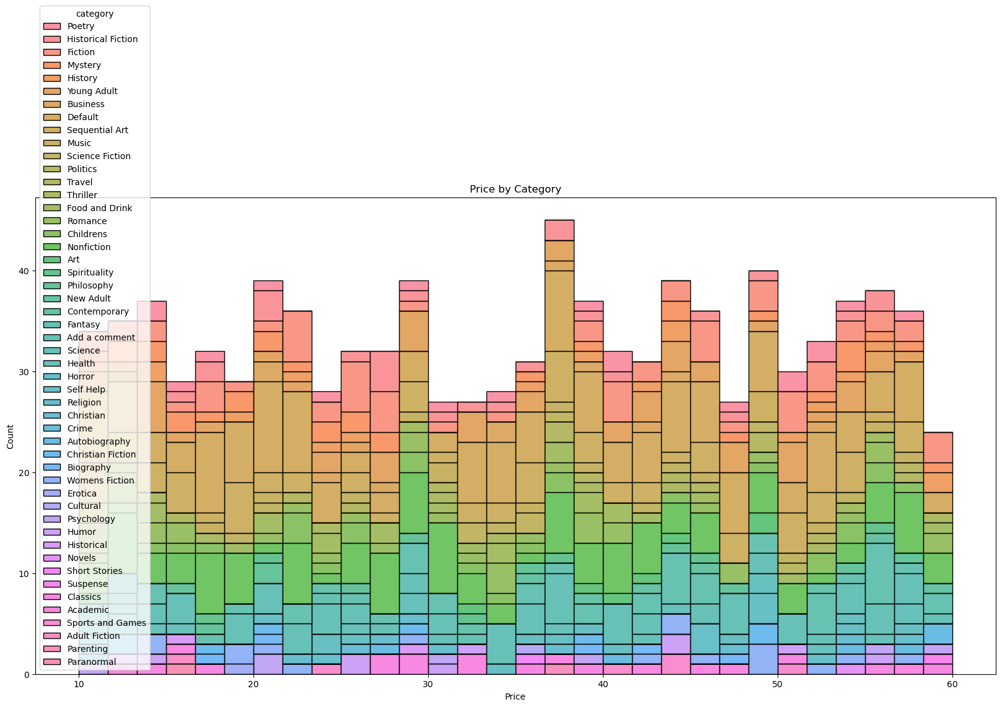
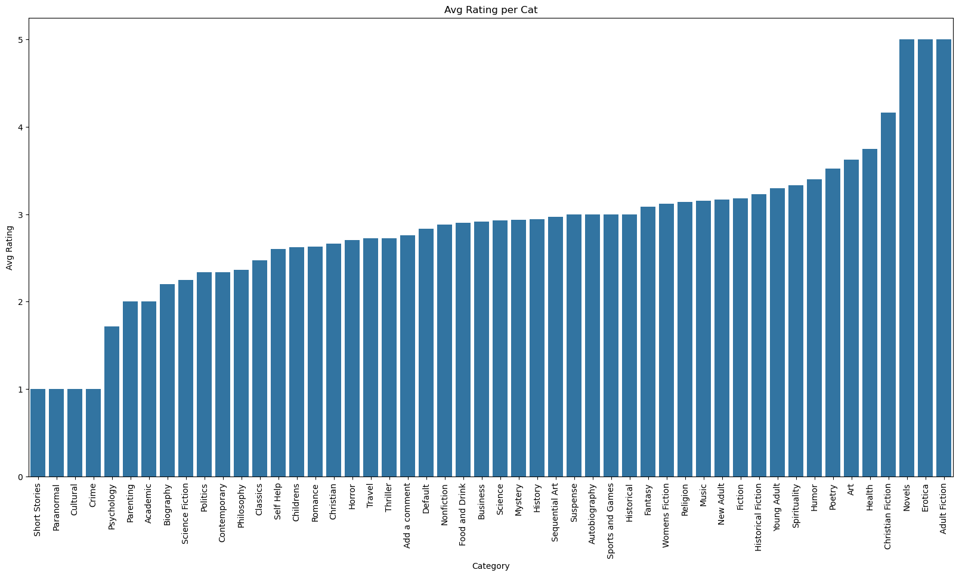
2.4 Visualization

Slide 17
Predictive Analysis
Predict pricing using the rating
Linear Regression
MSE
Train: 206.10
Test: 214.19
Not Overfitting
Weak Accuracy

Slide 18
3 Data Ethics: AI Ethics in Healthcare Data
Skin Cancer Detection Model
Privacy Challenges - No patient identification data extracted
Bias
Demographic - 80% of images comes from male patients age over 50
Geographical - 100% of images comes from USA
Socioeconomic – 80 % of images from homeless hospitals
Ethical decision Making
Consent for using on AI
Secured
Data Audit
AI decision confirm from doctors
Carefully communicate unforeseen future risks

Slide 19
3 Data Ethics: AI Ethics in Healthcare Data
Stakeholder Impact Analysis – Case Skin Cancer
Patients
Faster Diagnosis
Avoid radioactive materials
Risks of False detection (accuracy of the model)
Health Care Professionals
Need to train the interpreting the out put from AI
Trust
Researchers
Large dataset innovations but need to ensure data is used ethically

